Slide 1
Writing Basic SQL Statements
Notes:
Schedule: Timing Topic
40 minutes Lecture
25 minutes Practice
65 minutes Total

Slide 2


Slide 3
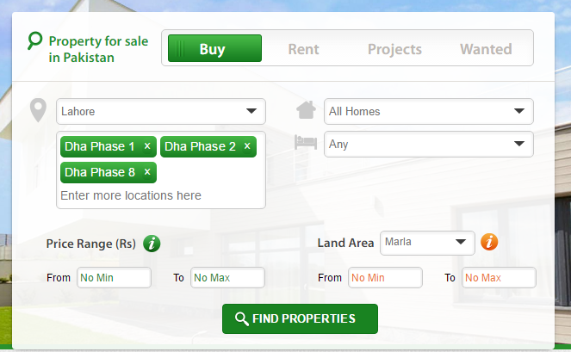

Slide 4
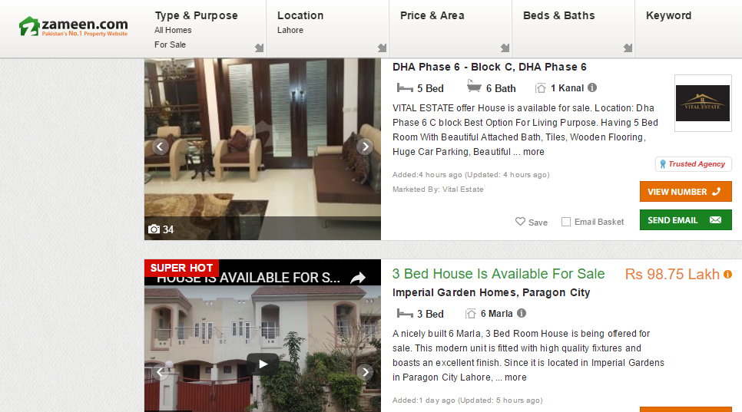

Slide 5
Objectives
After completing this lesson, you should be able to do the following:
List the capabilities of SQL SELECT statements
Execute a basic SELECT statement
Notes:
Lesson Aim
To extract data from the database, you need to use the structured query language (SQL) SELECT statement. You may need to restrict the columns that are displayed. This lesson describes all the SQL statements that you need to perform these actions. You may want to create SELECT statements that can be used time and time again. This lesson also covers the use of SQL*Plus commands to execute SQL statements.

Slide 6
Capabilities of SQL SELECT Statements
Selection
Projection
Table 1
Table 1
Join
Table 1
Table 2
Notes:
Capabilities of SQL SELECT Statements
A SELECT statement retrieves information from the database. Using a SELECT statement, you can do the following:
Selection: You can use the selection capability in SQL to choose the rows in a table that you want returned by a query. You can use various criteria to selectively restrict the rows that you see.
Projection: You can use the projection capability in SQL to choose the columns in a table that you want returned by your query. You can choose as few or as many columns of the table as you require.
Join: You can use the join capability in SQL to bring together data that is stored in different tables by creating a link through a column that both the tables share. You will learn more about joins in a later lesson.

Slide 7
Basic SELECT Statement
SELECT [DISTINCT] {*, column [alias],...}
FROM table;
SELECT identifies what columns.
FROM identifies which table.
Notes:
Basic SELECT Statement
In its simplest form, a SELECT statement must include the following:
A SELECT clause, which specifies the columns to be displayed
A FROM clause, which specifies the table containing the columns listed in the SELECT clause
In the syntax:
SELECT is a list of one or more columns.
DISTINCT suppresses duplicates.
* selects all columns.
column selects the named column.
alias gives selected columns different headings.
FROM table specifies the table containing the columns.
Note: Throughout this course, the words keyword, clause, and statement are used.
A keyword refers to an individual SQL element. For example, SELECT and FROM are keywords.
A clause is a part of an SQL statement. For example, SELECT empno, ename, ... is a clause.
A statement is a combination of two or more clauses. For example, SELECT * FROM emp is a SQL statement.

Slide 8
Writing SQL Statements
SQL statements are not case sensitive.
SQL statements can be on one or more lines.
Keywords cannot be abbreviated or split across lines.
Clauses are usually placed on separate lines.
Tabs and indents are used to enhance readability.
Notes:
Writing SQL Statements
Using the following simple rules and guidelines, you can construct valid statements that are both easy to read and easy to edit:
• SQL statements are not case sensitive, unless indicated.
SQL statements can be entered on one or many lines.
• Keywords cannot be split across lines or abbreviated.
Clauses are usually placed on separate lines for readability and ease of editing.
• Tabs and indents can be used to make code more readable.
Keywords typically are entered in uppercase; all other words, such as table names and columns, are entered in lowercase.
• Within SQL*Plus, a SQL statement is entered at the SQL prompt, and the subsequent lines are numbered. This is called the SQL buffer. Only one statement can be current at any time within the buffer.
Executing SQL Statements
Place a semicolon (;) at the end of the last clause.
Place a slash on the last line in the buffer.
Place a slash at the SQL prompt.
Issue a SQL*Plus RUN command at the SQL prompt.

Slide 9
Selecting All Columns
SQL> SELECT *
2 FROM dept;
DEPTNO DNAME LOC
--------- -------------- -------------
10 ACCOUNTING NEW YORK
20 RESEARCH DALLAS
30 SALES CHICAGO
40 OPERATIONS BOSTON
Notes:
Selecting All Columns, All Rows
You can display all columns of data in a table by following the SELECT keyword with an asterisk (*). In the example on the slide, the department table contains three columns: DEPTNO, DNAME, and LOC. The table contains four rows, one for each department.
You can also display all columns in the table by listing all the columns after the SELECT keyword. For example, the following SQL statement, like the example on the slide, displays all columns and all rows of the DEPT table:
Class Management Note
Let the students know that details of all the tables are given in Appendix B.
SQL> SELECT deptno, dname, loc
2 FROM dept;

Slide 10
Selecting Specific Columns
SQL> SELECT deptno, loc
2 FROM dept;
DEPTNO LOC
--------- -------------
10 NEW YORK
20 DALLAS
30 CHICAGO
40 BOSTON
Notes:
Selecting Specific Columns, All Rows
You can use the SELECT statement to display specific columns of the table by specifying the column names, separated by commas. The example on the slide displays all the department numbers and locations from the DEPT table.
In the SELECT clause, specify the columns that you want to see, in the order in which you want them to appear in the output. For example, to display location before department number, you use the following statement:
Class Management Note
You can also select from pseudocolumns. A pseudocolumn behaves like a table column but is not actually stored in the table. You cannot insert or delete values of the pseudocolumns. The available pseudocolumns are CURRVAL, NEXTVAL, LEVEL, ROWID, and ROWNUM.

Slide 11
Column Heading Defaults
Default justification
Left: Date and character data
Right: Numeric data
Default display: Uppercase
Notes:
Column Heading Defaults
Character column heading and data as well as date column heading and data are left-justified within a column width. Number headings and data are right-justified.
Character and date column headings can be truncated, but number headings cannot be truncated. The column headings appear in uppercase by default. You can override the column heading display with an alias. Column aliases are covered later in this lesson.
SQL> SELECT ename, hiredate, sal
2 FROM emp;
ENAME HIREDATE SAL
---------- --------- ---------
KING 17-NOV-81 5000
BLAKE 01-MAY-81 2850
CLARK 09-JUN-81 2450
JONES 02-APR-81 2975
MARTIN 28-SEP-81 1250
ALLEN 20-FEB-81 1600
...
14 rows selected.

Slide 12
Arithmetic Expressions
Create expressions on NUMBER and DATE data by using arithmetic operators.
Operator
+
-
*
/
Description
Add
Subtract
Multiply
Divide
Notes:
Arithmetic Expressions
You may need to modify the way in which data is displayed, perform calculations, or look at what-if scenarios. This is possible using arithmetic expressions. An arithmetic expression may contain column names, constant numeric values, and the arithmetic operators.
Arithmetic Operators
The slide lists the arithmetic operators available in SQL. You can use arithmetic operators in any clause of a SQL statement except the FROM clause.

Slide 13
Using Arithmetic Operators
SQL> SELECT ename, sal, sal+300
2 FROM emp;
ENAME SAL SAL+300
---------- --------- ---------
KING 5000 5300
BLAKE 2850 3150
CLARK 2450 2750
JONES 2975 3275
MARTIN 1250 1550
ALLEN 1600 1900
...
14 rows selected.
Notes:
Using Arithmetic Operators
The example in the slide uses the addition operator to calculate a salary increase of $300 for all employees and displays a new SAL+300 column in the output.
Note that the resultant calculated column SAL+300 is not a new column in the EMP table; it is for display only. By default, the name of a new column comes from the calculation that generated it—in this case, sal+300.
Note: SQL*Plus ignores blank spaces before and after the arithmetic operator.

Slide 14
Operator Precedence
_
*
/
+
Multiplication and division take priority over addition and subtraction.
Operators of the same priority are evaluated from left to right.
Parentheses are used to force prioritized evaluation and to clarify statements.
Notes:
Operator Precedence
If an arithmetic expression contains more than one operator, multiplication and division are evaluated first. If operators within an expression are of same priority, then evaluation is done from left to right.
You can use parentheses to force the expression within parentheses to be evaluated first.

Slide 15
Operator Precedence
SQL> SELECT ename, sal, 12*sal+100
FROM emp;
ENAME SAL 12*SAL+100
---------- --------- ----------
KING 5000 60100
BLAKE 2850 34300
CLARK 2450 29500
JONES 2975 35800
MARTIN 1250 15100
ALLEN 1600 19300
...
14 rows selected.
Notes:
Operator Precedence (continued)
The example on the slide displays the name, salary, and annual compensation of employees. It calculates the annual compensation as 12 multiplied by the monthly salary, plus a one-time bonus of $100. Notice that multiplication is performed before addition.
Note: Use parentheses to reinforce the standard order of precedence and to improve clarity. For example, the expression above can be written as (12*sal)+100 with no change in the result.
Class Management Note
Demo: l1prec1.sql, l1prec2.sql
Purpose: To illustrate viewing a query containing no parentheses and executing a query with parentheses to override rules of precedence.

Slide 16
Using Parentheses
SQL> SELECT ename, sal, 12*(sal+100)
2 FROM emp;
ENAME SAL 12*(SAL+100)
---------- --------- -----------
KING 5000 61200
BLAKE 2850 35400
CLARK 2450 30600
JONES 2975 36900
MARTIN 1250 16200
...
14 rows selected.
Notes:
Using Parentheses
You can override the rules of precedence by using parentheses to specify the order in which operators are executed.
The example on the slide displays the name, salary, and annual compensation of employees. It calculates the annual compensation as monthly salary plus a monthly bonus of $100, multiplied by 12. Because of the parentheses, addition takes priority over multiplication.

Slide 17
Defining a Null Value
A null is a value that is unavailable, unassigned, unknown, or inapplicable.
A null is not the same as zero or a blank space.
SQL> SELECT ename, job, comm
2 FROM emp;
ENAME JOB COMM
---------- --------- ---------
KING PRESIDENT
BLAKE MANAGER
...
TURNER SALESMAN 0
...
14 rows selected.
Notes:
Null Values
If a row lacks the data value for a particular column, that value is said to be null, or to contain null.
A null value is a value that is unavailable, unassigned, unknown, or inapplicable. A null value is not the same as zero or a space. Zero is a number, and a space is a character.
Columns of any datatype can contain null values, unless the column was defined as NOT NULL or as PRIMARY KEY when the column was created.
In the COMM column in the EMP table, you notice that only a SALESMAN can earn commission. Other employees are not entitled to earn commission. A null value represents that fact. Turner, who is a salesman, does not earn any commission. Notice that his commission is zero and not null.
Class Management Note
Demo: l1null.sql
Purpose: To illustrate calculating with null values.

Slide 18
Null Values in Arithmetic Expressions
Arithmetic expressions containing a null value evaluate to null.
SQL> select ename, 12*sal+comm
2 from emp
3 WHERE ename='KING';
ENAME 12*SAL+COMM
---------- -----------
KING
Notes:
Null Values (continued)
If any column value in an arithmetic expression is null, the result is null. For example, if you attempt to perform division with zero, you get an error. However, if you divide a number by null, the result is a null or unknown.
In the example on the slide, employee KING is not in SALESMAN and does not get any commission. Because the COMM column in the arithmetic expression is null, the result is null.
For more information, see Oracle Server SQL Reference, Release 8, “Elements of SQL.”

Slide 19
Defining a Column Alias
Renames a column heading
Is useful with calculations
Immediately follows column name; optional AS keyword between column name and alias
Requires double quotation marks if it contains spaces or special characters or is case sensitive
Notes:
Column Aliases
When displaying the result of a query, SQL*Plus normally uses the name of the selected column as the column heading. In many cases, this heading may not be descriptive and hence is difficult to understand. You can change a column heading by using a column alias.
Specify the alias after the column in the SELECT list using a space as a separator. By default, alias headings appear in uppercase. If the alias contains spaces, special characters (such as # or $), or is case sensitive, enclose the alias in double quotation marks (" ").
Class Management Note
Within a SQL statement, a column alias can be used in both the SELECT clause and the ORDER BY clause. You cannot use column aliases in the WHERE clause. Both alias features comply with the ANSI SQL 92 standard.
Demo: l1alias.sql
Purpose: To illustrate the use of aliases in expressions.

Slide 20
Using Column Aliases
SQL> SELECT ename AS name, sal salary
2 FROM emp;
NAME SALARY
------------- --------- ...
SQL> SELECT ename "Name",
2 sal*12 "Annual Salary"
3 FROM emp;
Name Annual Salary
------------- ------------- ...
Notes:
Column Aliases (continued)
The first example displays the name and the monthly salary of all the employees. Notice that the optional AS keyword has been used before the column alias name. The result of the query would be the same whether the AS keyword is used or not. Also notice that the SQL statement has the column aliases, name and salary, in lowercase, whereas the result of the query displays the column headings in uppercase. As mentioned in the last slide, column headings appear in uppercase by default.
The second example displays the name and annual salary of all the employees. Because Annual Salary contains spaces, it has been enclosed in double quotation marks. Notice that the column heading in the output is exactly the same as the column alias.
Class Management Note
Point out the optional AS keyword in the first example and the double quotation marks in the second example. Also show that the aliases always appear in uppercase, unless enclosed within double quotation marks.

Slide 21
Concatenation Operator
Concatenates columns or character strings to other columns
Is represented by two vertical bars (||)
Creates a resultant column that is a character expression
Notes:
Concatenation Operator
You can link columns to other columns, arithmetic expressions, or constant values to create a character expression by using the concatenation operator (||). Columns on either side of the operator are combined to make a single output column.

Slide 22
Using the Concatenation Operator
SQL> SELECT ename||job AS "Employees"
2 FROM emp;
Employees
-------------------
KINGPRESIDENT
BLAKEMANAGER
CLARKMANAGER
JONESMANAGER
MARTINSALESMAN
ALLENSALESMAN
...
14 rows selected.
Notes:
Concatenation Operator (continued)
In the example, ENAME and JOB are concatenated, and they are given the alias Employees. Notice that the employee number and job are combined to make a single output column.
The AS keyword before the alias name makes the SELECT clause easier to read.

Slide 23
Literal Character Strings
A literal is a character, expression, or number included in the SELECT list.
Date and character literal values must be enclosed within single quotation marks.
Each character string is output once for each row returned.
Notes:
Literal Character Strings
A literal is any character, expression, or number included in the SELECT list that is not a column name or a column alias. It is printed for each row returned. Literal strings of free-format text can be included in the query result and are treated the same as a column in the SELECT list.
Date and character literals must be enclosed within single quotation marks (' '); number literals must not.

Slide 24
Using Literal Character Strings
SQL> SELECT ename ||' '||'is a'||' '||job
2 AS "Employee Details"
3 FROM emp;
Employee Details
-------------------------
KING is a PRESIDENT
BLAKE is a MANAGER
CLARK is a MANAGER
JONES is a MANAGER
MARTIN is a SALESMAN
...
14 rows selected.
Notes:
Literal Character Strings (continued)
The example on the slide displays names and jobs of all employees. The column has the heading Employee Details. Notice the spaces between the single quotation marks in the SELECT statement. The spaces improve the readability of the output.
In the following example, the name and salary for each employee is concatenated with a literal to give the returned rows more meaning.

Slide 25
Duplicate Rows
The default display of queries is all rows, including duplicate rows.
SQL> SELECT deptno
2 FROM emp;
DEPTNO
---------
10
30
10
20
...
14 rows selected.
Notes:
Duplicate Rows
Unless you indicate otherwise, SQL*Plus displays the results of a query without eliminating duplicate rows. The example on the slide displays all the department numbers from the EMP table. Notice that the department numbers are repeated.

Slide 26
Eliminating Duplicate Rows
Eliminate duplicate rows by using the DISTINCT keyword in the SELECT clause.
SQL> SELECT DISTINCT deptno
2 FROM emp;
DEPTNO
---------
10
20
30
Notes:
Duplicate Rows (continued)
To eliminate duplicate rows in the result, include the DISTINCT keyword in the SELECT clause immediately after the SELECT keyword. In the example on the slide, the EMP table actually contains fourteen rows but there are only three unique department numbers in the table.
You can specify multiple columns after the DISTINCT qualifier. The DISTINCT qualifier affects all the selected columns, and the result represents a distinct combination of the columns.
DEPTNO JOB
------ ---------
10 CLERK
10 MANAGER
10 PRESIDENT
20 ANALYST
...
9 rows selected.
SQL> SELECT DISTINCT deptno, job
2 FROM emp;

Slide 27
Displaying Table Structure
Use the SQL*Plus DESCRIBE command to display the structure of a table.
DESC[RIBE] tablename
Notes:
Displaying Table Structure
In SQL*Plus, you can display the structure of a table using the DESCRIBE command. The result of the command is to see the column names and datatypes as well as whether a column must contain data.
In the syntax:
tablename is the name of any existing table, view, or synonym accessible to the user

Slide 28
Displaying Table Structure
SQL> DESCRIBE dept
Name Null? Type
----------------- -------- ------------
DEPTNO NOT NULL NUMBER(2)
DNAME VARCHAR2(14)
LOC VARCHAR2(13)
Notes:
Displaying Table Structure (continued)
The example on the slide displays the information about the structure of the DEPT table.
In the result:
Null? indicates whether a column must contain data; NOT NULL indicates that a column must contain data
Type displays the datatype for a column
The datatypes are described in the following table:

Slide 29
Practice Overview
Selecting all data from different tables
Describing the structure of tables
Performing arithmetic calculations and specifying column names
Using SQL*Plus editor
Notes:
Practice Overview
This is the first of many practices. The solutions (if you require them) can be found in Appendix A. Practices are intended to introduce all topics covered in the lesson. Questions 2–4 are paper-based.
In any practice, there may be “if you have time” or “if you want extra challenge” questions. Do these only if you have completed all other questions within the allocated time and would like a further challenge to your skills.
Take the practice slowly and precisely. You can experiment with saving and running command files. If you have any questions at any time, attract the instructor’s attention.
Paper-Based Questions
For questions 2–4 circle either True or False.

Slide 30
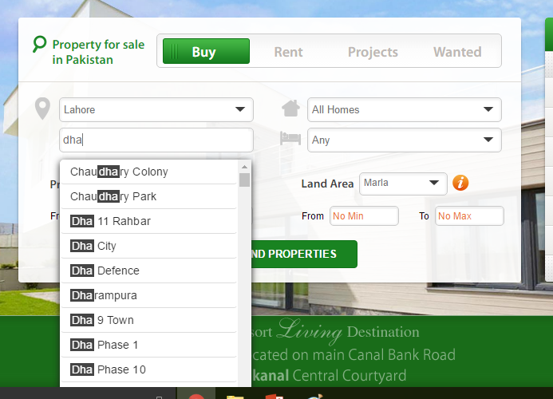

Slide 31
Other comparison operators
Operator
BETWEEN ...AND...
IN(list)
LIKE
IS NULL
Meaning
Between two values (inclusive)
Match any of a list of values
Match a character pattern
Is a null value

Slide 32
Using the Between operator
Using the between operator to display rows based on a range
SQL> SELECT ename, sal
2 FROM emp
3 WHERE sal BETWEEN 1000 AND 1500;
ENAME SAL
---------- ---------
MARTIN 1250
TURNER 1500
WARD 1250
ADAMS 1100
MILLER 1300
Lower limit
Higher limit
Notes:
The BETWEEN Operator
You can display rows based on a range of values using the BETWEEN operator. The range that you specify contains a lower range and an upper range.
The SELECT statement on the slide returns rows from the EMP table for any employee whose salary is between $1000 and $1500.
Values specified with the BETWEEN operator are inclusive. You must specify the lower limit first.
Class Management Note
Emphasize that the values specified with the BETWEEN operator in the example are inclusive. Point out that Turner, who earns $1500 (higher limit), is included in the output.
Demo: l2betw.sql
Purpose: To illustrate using the BETWEEN operator.

Slide 34
Using the IN operator
Use the IN operator to test for values in a list
SQL> SELECT empno, ename, sal, mgr
2 FROM emp
3 WHERE mgr IN (7902, 7566, 7788);
EMPNO ENAME SAL MGR
--------- ---------- --------- ---------
7902 FORD 3000 7566
7369 SMITH 800 7902
7788 SCOTT 3000 7566
7876 ADAMS 1100 7788
Notes:
The IN Operator
To test for values in a specified list, use the IN operator.
The slide example displays employee number, name, salary, and manager’s employee number of all the employees whose manager’s employee number is 7902, 7566, or 7788.
The IN operator can be used with any datatype. The following example returns a row from the EMP table for any employee whose name is included in the list of names in the WHERE clause:
SQL> SELECT empno, ename, mgr, deptno
2 FROM emp
3 WHERE ename IN ('FORD' , 'ALLEN');
If characters or dates are used in the list, they must be enclosed in single quotation marks ('').
Class Management Note
Demo: l2in.sql
Purpose: To illustrate using the IN operator.

Slide 35
Using the LIKE operator
Use the LIKE operator to perform wildcard searches of valid search string values
Search conditions can contain either literal characters or numbers
% denotes zero or many characters
_ denotes one character
SQL> SELECT ename
2 FROM emp
3 WHERE ename LIKE 'S%';
Notes:
The LIKE Operator
You may not always know the exact value to search for. You can select rows that match a character pattern by using the LIKE operator. The character pattern-matching operation is referred to as a wildcard search. Two symbols can be used to construct the search string.
The SELECT statement above returns the employee name from the EMP table for any employee whose name begins with an “S.” Note the uppercase “S.” Names beginning with an “s” will not be returned.
The LIKE operator can be used as a shortcut for some BETWEEN comparisons. The following example displays names and hire dates of all employees who joined between January 1981 and December 1981:
SQL> SELECT ename, hiredate
2 FROM emp
3 WHERE hiredate LIKE '%81';

Slide 36
Using the LIKE operator
You can combine pattern-matching characters
SQL> SELECT ename
2 FROM emp
3 WHERE ename LIKE '_A%';
ENAME
----------
MARTIN
JAMES
WARD
Notes:
Combining Wildcard Characters
The % and _ symbols can be used in any combination with literal characters. The example on the slide displays the names of all employees whose name has an “A” as the second character.
The ESCAPE Option
When you need to have an exact match for the actual ‘%’ and ‘_’ characters, use the ESCAPE option. This option specifies what the ESCAPE character is. To display the names of employees whose name contains ‘A_B’, use the following SQL statement:
The ESCAPE option identifies the backslash (\) as the escape character. In the pattern, the escape character precedes the underscore (_). This causes the Oracle Server to interpret the underscore literally.
SQL> SELECT ename
2 FROM emp
3 WHERE ename LIKE '%A\_B%' ESCAPE '\';

Slide 37
Using the IS NULL operator
Test for null values with the IS NULL operator
SQL> SELECT ename, mgr
2 FROM emp
3 WHERE mgr IS NULL;
ENAME MGR
---------- ---------
KING
Notes:
The IS NULL Operator
The IS NULL operator tests for values that are null. A null value means the value is unavailable, unassigned, unknown, or inapplicable. Therefore, you cannot test with (=) because a null value cannot be equal or unequal to any value. The slide example retrieves the name and manager of all employees who do not have a manager.
For example, to display name, job title, and commission for all employees who are not entitled to get a commission, use the following SQL statement:
ENAME JOB COMM
-------- ----------- ------
KING PRESIDENT
BLAKE MANAGER
CLARK MANAGER
...

Slide 38
Logical Operators
Operator
AND OR
NOT
Meaning
Returns TRUE if both component conditions are TRUE
Returns TRUE if either component condition is TRUE
Returns TRUE if the following condition is FALSE
Notes:
Logical Operators
A logical operator combines the result of two component conditions to produce a single result based on them or to invert the result of a single condition. Three logical operators are available in SQL:
AND
OR
NOT
All the examples so far have specified only one condition in the WHERE clause. You can use several conditions in one WHERE clause using the AND and OR operators.

Slide 40
Using the OR operator
OR requires either condition to be TRUE
SQL> SELECT empno, ename, job, sal
2 FROM emp
3 WHERE sal>=1100
4 OR job='CLERK';
EMPNO ENAME JOB SAL
--------- ---------- --------- ---------
7839 KING PRESIDENT 5000
7698 BLAKE MANAGER 2850
7782 CLARK MANAGER 2450
7566 JONES MANAGER 2975
7654 MARTIN SALESMAN 1250
...
7900 JAMES CLERK 950
...
14 rows selected.
Notes:
The OR Operator
In the example, either condition can be true for any record to be selected. Therefore, an employee who has a job title of CLERK or earns more than $1100 will be selected.
The OR Truth Table
The following table shows the results of combining two expressions with OR:
Class Management Note
Demo: l2or.sql
Purpose: To illustrate using the OR operator.

Slide 41
Using the NOT operator
SQL> SELECT ename, job
2 FROM emp
3 WHERE job NOT IN ('CLERK','MANAGER','ANALYST');
ENAME JOB
---------- ---------
KING PRESIDENT
MARTIN SALESMAN
ALLEN SALESMAN
TURNER SALESMAN
WARD SALESMAN
Notes:
The NOT Operator
The slide example displays name and job title of all the employees whose job title is not CLERK, MANAGER, or ANALYST.
The NOT Truth Table
The following table shows the result of applying the NOT operator to a condition:
Note: The NOT operator can also be used with other SQL operators, such as BETWEEN, LIKE, and NULL.
... WHERE NOT job IN ('CLERK', 'ANALYST')
... WHERE sal NOT BETWEEN 1000 AND 1500
... WHERE ename NOT LIKE '%A%'
... WHERE comm IS NOT NULL

Slide 42
Rule of Precedence
Order Evaluated Operator
1 All comparison operators
2 NOT
3 AND
4 OR
Override rule of precedence by using parantheses

Slide 43
Rule of Precedence
SQL> SELECT ename, job, sal
2 FROM emp
3 WHERE job='SALESMAN'
4 OR job='PRESIDENT'
5 AND sal>1500;
ENAME JOB SAL
---------- --------- ---------
KING PRESIDENT 5000
MARTIN SALESMAN 1250
ALLEN SALESMAN 1600
TURNER SALESMAN 1500
WARD SALESMAN 1250
Notes:
Example of Precedence of AND Operator
In the slide example, there are two conditions:
The first condition is that job is PRESIDENT and salary is greater than 1500.
The second condition is that job is SALESMAN.
Therefore, the SELECT statement reads as follows:
“Select the row if an employee is a PRESIDENT and earns more than $1500 or if the employee is a SALESMAN.”
Class Management Note
Demo: l2sal1.sql
Purpose: To illustrate the rules of precedence.

Slide 44
Rule of Precedence
Use parentheses to force priority
SQL> SELECT ename, job, sal
2 FROM emp
3 WHERE (job='SALESMAN'
4 OR job='PRESIDENT')
5 AND sal>1500;
ENAME JOB SAL
---------- --------- ---------
KING PRESIDENT 5000
ALLEN SALESMAN 1600
Notes:
Using Parentheses
In the example, there are two conditions:
The first condition is that job is PRESIDENT or SALESMAN.
The second condition is that salary is greater than 1500.
Therefore, the SELECT statement reads as follows:
“Select the row if an employee is a PRESIDENT or a SALESMAN and if the employee earns more than $1500.”
Class Management Note
Demo: l2sal2.sql
Purpose: To illustrate the rules of precedence.

Slide 45
Order by clause
Soft rows with the ORDER BY clause
ASC: Ascending order, default
DESC: descending order
The ORDER BY clause comes last in the select statement
SQL> SELECT ename, job, deptno, hiredate
2 FROM emp
3 ORDER BY hiredate;
ENAME JOB DEPTNO HIREDATE
---------- --------- --------- ---------
SMITH CLERK 20 17-DEC-80
ALLEN SALESMAN 30 20-FEB-81
...
14 rows selected.
Notes:
The ORDER BY Clause
The order of rows returned in a query result is undefined. The ORDER BY clause can be used to sort the rows. If you use the ORDER BY clause, you must place last. You can specify an expression or an alias to sort.
Syntax
SELECT expr
FROM table
[WHERE condition(s)]
[ORDER BY {column, expr} [ASC|DESC]];
where: ORDER BY specifies the order in which the retrieved rows are displayed
ASC orders the rows in ascending order (this is the default order)
DESC orders the rows in descending order
If the ORDER BY clause is not used, the sort order is undefined, and the Oracle Server may not fetch rows in the same order for the same query twice. Use the ORDER BY clause to display the rows in a specific order.

Slide 46
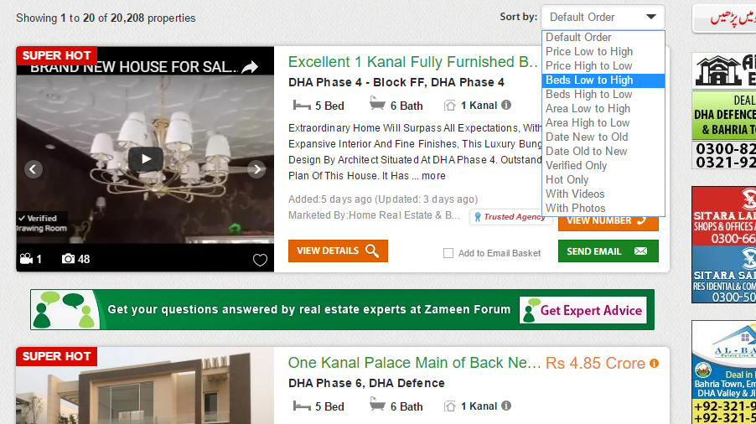

Slide 47
Sorting in Descending Order
SQL> SELECT ename, job, deptno, hiredate
2 FROM emp
3 ORDER BY hiredate DESC;
ENAME JOB DEPTNO HIREDATE
---------- --------- --------- ---------
ADAMS CLERK 20 12-JAN-83
SCOTT ANALYST 20 09-DEC-82
MILLER CLERK 10 23-JAN-82
JAMES CLERK 30 03-DEC-81
FORD ANALYST 20 03-DEC-81
KING PRESIDENT 10 17-NOV-81
MARTIN SALESMAN 30 28-SEP-81
...
14 rows selected.
Notes:
Default Ordering of Data
The default sort order is ascending:
Numeric values are displayed with the lowest values first—for example, 1–999.
Date values are displayed with the earliest value first—for example, 01-JAN-92 before 01-JAN-95.
Character values are displayed in alphabetical order—for example, A first and Z last.
Null values are displayed last for ascending sequences and first for descending sequences.
Reversing the Default Order
To reverse the order in which rows are displayed, specify the keyword DESC after the column name in the ORDER BY clause. The slide example sorts the result by the most recently hired employee.

Slide 48
Sorting by Multiple Columns
The order to ORDER BY list is the order of sort
SQL> SELECT ename, deptno, sal
2 FROM emp
3 ORDER BY deptno, sal DESC;
ENAME DEPTNO SAL
---------- --------- ---------
KING 10 5000
CLARK 10 2450
MILLER 10 1300
FORD 20 3000
...
14 rows selected.
You can sort by a column that is not in the SELECT list
Notes:
Sorting by Multiple Columns
You can sort query results by more than one column. The sort limit is the number of columns in the given table.
In the ORDER BY clause, specify the columns, and separate the column names using commas. If you want to reverse the order of a column, specify DESC after its name. You can order by columns that are not included in the SELECT clause.
Example
Display name and salary of all employees. Order the result by department number and then descending order by salary.
Class Management Note
Show that the DEPTNO column is sorted in ascending order and the SAL column in descending order.

Slide 49
Exercise
Display the name and salary of employees earning more than 2850$
The name and salary for all employees whose salary is not in the range of 1500$ and 2850$

Slide 50
Exercise
Find the Names, job and state date (hiredate) of employees between 20 February 1981 and May 1, 1981 in ascending order

Slide 51
Exercise
The name, job and salary for employees whose job is clerk or analyst and their salary is not equal to 1000, 3000, 4000

Slide 52
Exercise
The name, job and salary for employees whose job is clerk or analyst and their salary is not equal to 1000, 3000, 4000
Find the name, salary, and commission for all employees whose commission (CMM) amount is greater than their salary increased by 10%

